Slide 1

Houston, TX
2019
#XamDevSummit

Slide 2


Cognitive Services in Xamarin Applications
Veronika Kolesnikova
breakpointv16
Accessible advanced intelligence

Slide 3
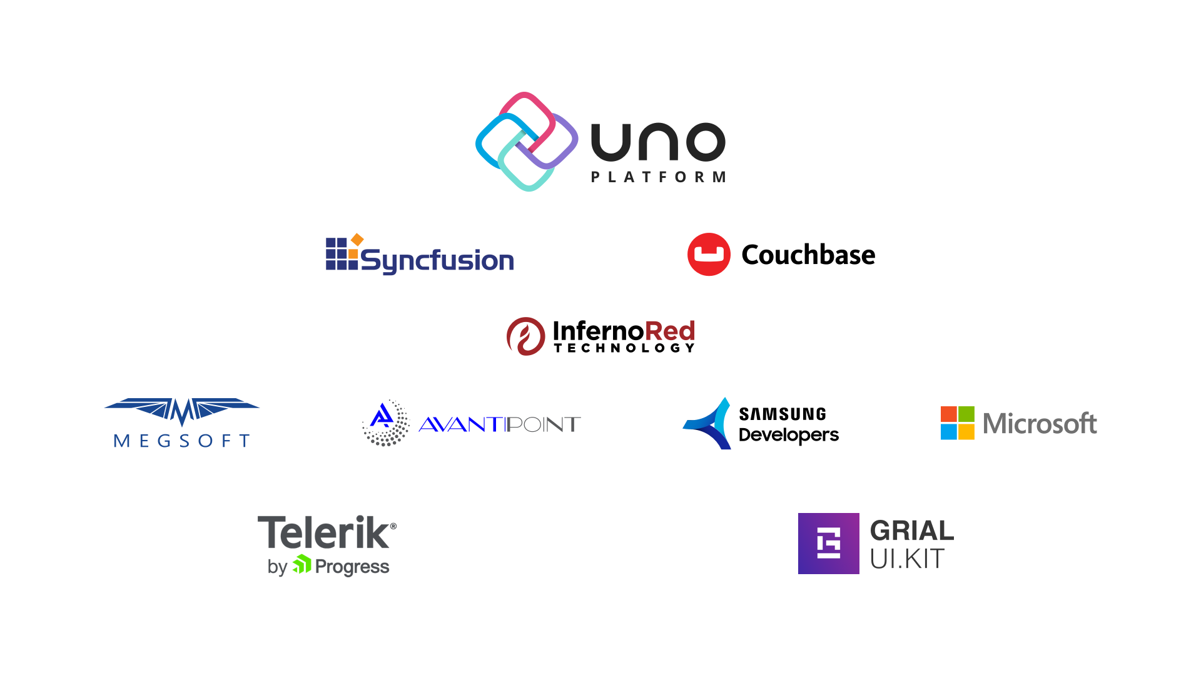

Slide 4
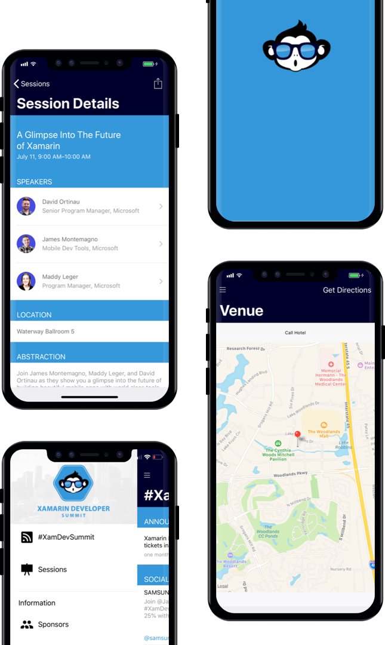
AGENDA
Download our Xamarin based mobile app: XamDevSummit.

Slide 5


Veronika Kolesnikova
Developer, Rightpoint Boston
Microsoft MVP AI
MS in Information Technology
3.5 years QA Experience
6+ years development experience
C#, .NET, SQL, Xamarin, .NET-based CMSes like EPiServer, Sitecore
PHP, MySQL, Drupal, RoR
Hobbies: dancing, travelling, aerial yoga

Slide 6


Agenda
Artificial intelligence and machine learning
Basics of Microsoft Cognitive Services
Groups and individual services
Microsoft AI Platform
Specifics of integrating Microsoft Cognitive Services with Xamarin
Demo

Slide 7
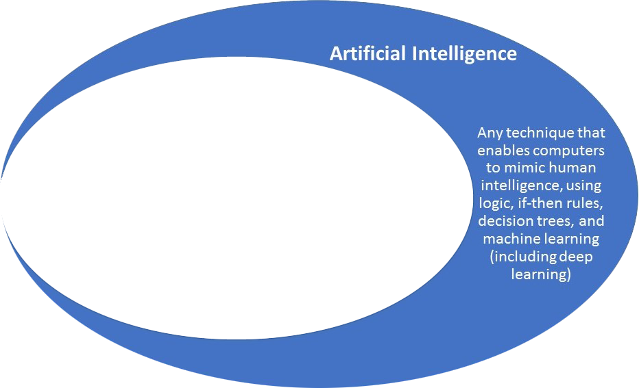
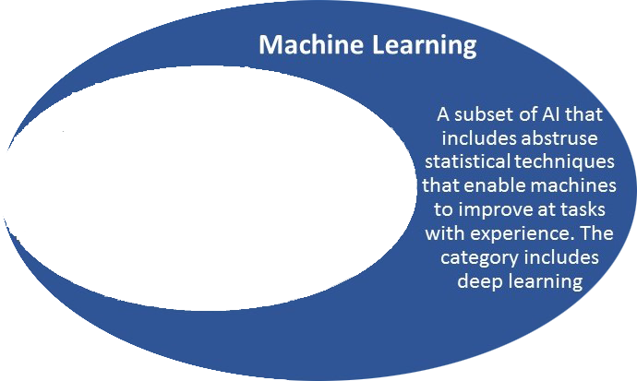
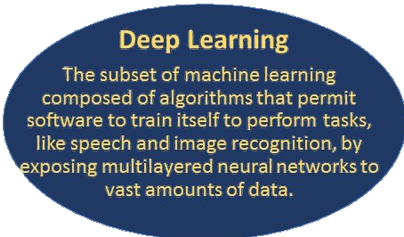
Artificial Intelligence and Machine Learning

Slide 8






What are Microsoft Cognitive services?
Get Key
Build
EASY |  | FLEXIBLE |  | TESTED
Simple to add: just a few lines of code |  | Integrate into the language and platform of your choice |  | Built by experts in their field from Microsoft Research, Bing and Azure Machine Learning
Get access with REST APIs |  | Breadth of offerings helps you find the right API for your app |  | Quality documentation, sample code, and community support

Slide 9
Groups of Cognitive Services
Vision
Computer Vision API
Video Indexer
Face API
Ink Recognizer*
Custom Vision Service
Form Recognizer**
Notes:
identify and analyze content within images, videos, and digital ink
Emotion merged into Face!
Computer Vision - This feature returns information about visual content found in an image.
Face API - Check the likelihood that two faces belong to the same person.
Content Moderator - Machine-assisted moderation of text and images, augmented with human review tools.
Custom model export (CoreML for iOS + Android upcoming!) https://www.customvision.ai/projects/7b3135ba-12fc-42f9-b094-659edf7a326f

Slide 10
Groups of Cognitive Services
Speech
Speech Services
Speaker Recognition*

Slide 11
Groups of Cognitive Services
Language
Language Understanding Intelligent Service
QnA Maker
Translator Text
Text Analytics
Immersive Reader*
Notes:
language services that ensure apps and services can understand the meaning of unstructured text or recognize the intent behind a speaker’s utterances.
Bots. Pre-built scenarios for LUIS

Slide 12
Groups of Cognitive Services
Decision
Content Moderator
Anomaly Detector*
Personalizer*
Notes:
Leverage these services that enable informed and efficient decision-making

Slide 13
Groups of Cognitive Services
Search
Bing Spell Check
Bing Web Search
Bing Visual Search
Bing Custom Search
Bing Video Search
Bing News Search
Bing Image Search
Bing Autosuggest
Notes:
Enable apps and services to harness the power of a Web-scale, ad-free search engine with Search. Use search services to find exactly what you’re looking for across billions of web pages, images, videos, and news search results.
Bing local business search*

Slide 14
Groups of Cognitive Services
Labs
Project URL Preview
Project Gesture
Project Local Insights
Project Event Tracking
Project Knowledge Exploration
Project Academic Knowledge
Notes:
12 for now + 17 AI labs ailab.microsoft.com

Slide 15

All APIs are available in Azure
Free tier includes 5000 transactions per month
No need to have Azure subscriptions to try Cognitive Services
Custom Vision Service has mobile model export

Slide 16
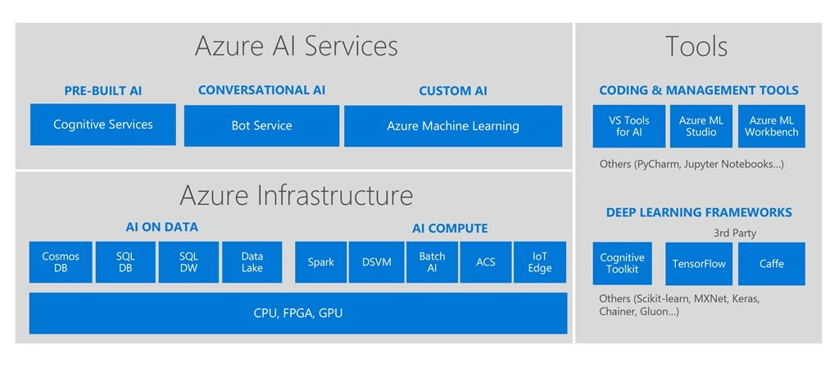
Microsoft AI Platform

Slide 17
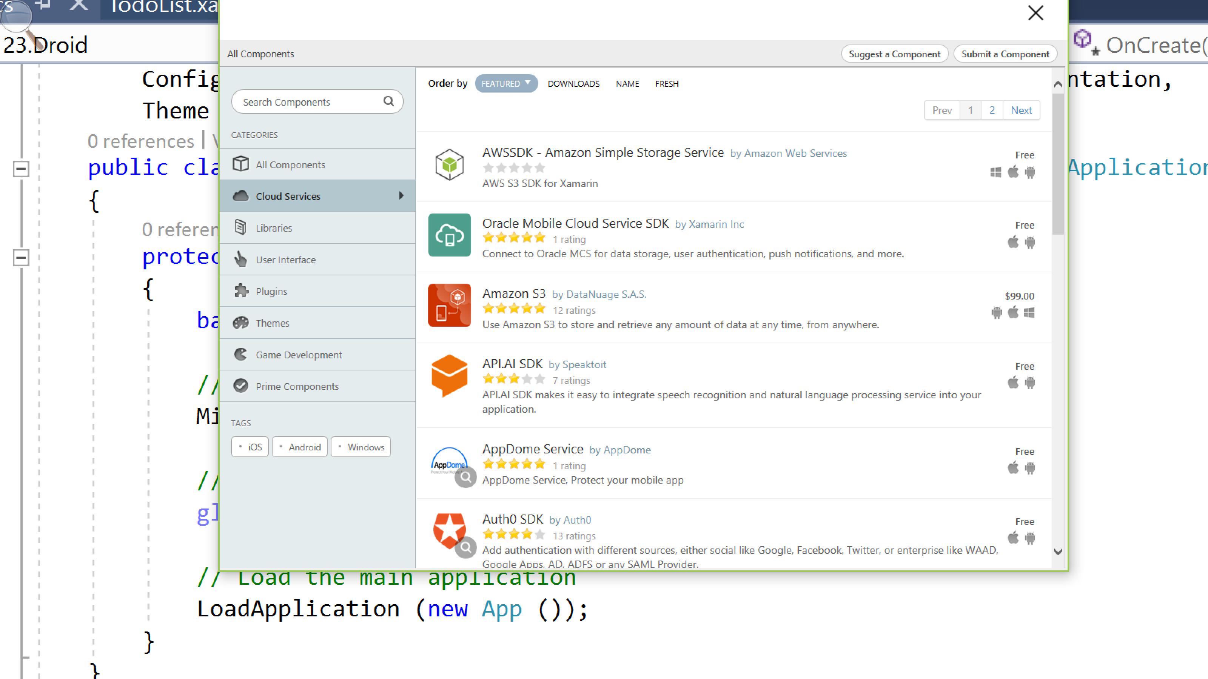
Native functionality
Device class
Dependency Service
double top;
switch (Device.RuntimePlatform)
{
case Device.iOS:
top = 20;
break;
case Device.Android:
case Device.WinPhone:
case Device.Windows:
default:
top = 0;
break;
}
layout.Margin = new Thickness(5, top, 5, 0);
Notes:
The Device class contains a number of properties and methods to help developers customize layout and functionality on a per-platform basis

Slide 18

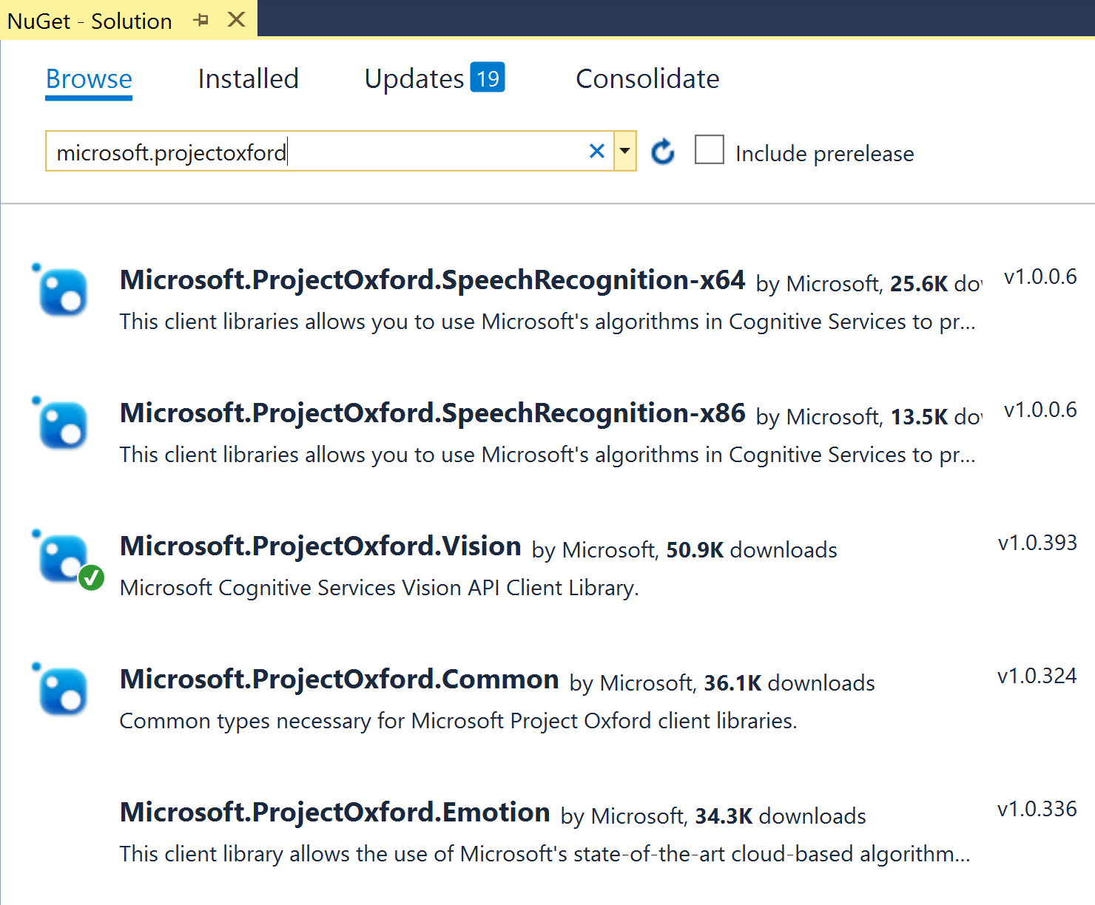
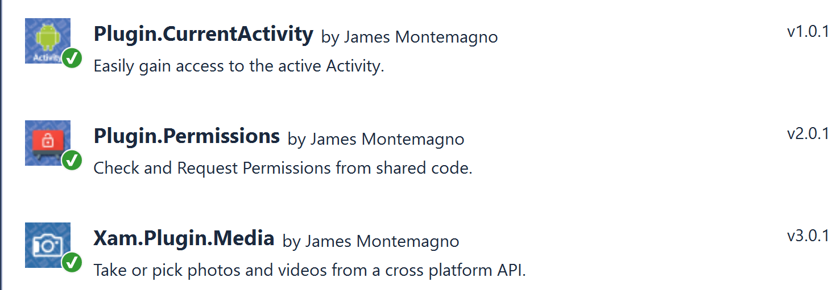
Where to start?
Microsoft.ProjectOxford
Microsoft.CognitiveServices
Xam.Plugin.Media
Notes:
Max – 40 min

Slide 19
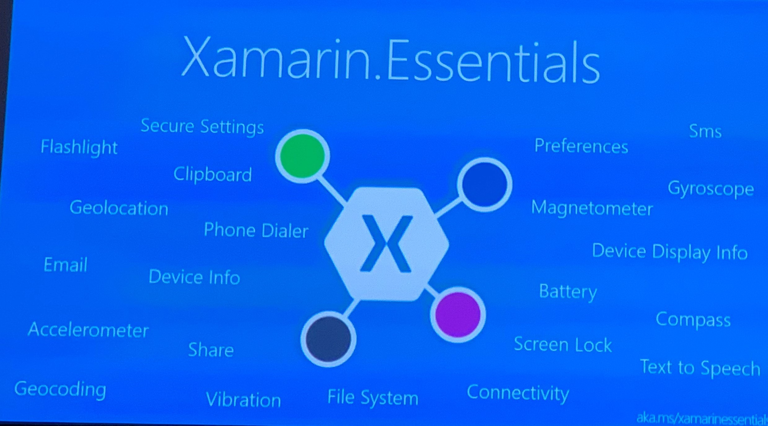

Slide 20
Demo

Slide 21
Useful links
Microsoft Cognitive Services Documentation: https://docs.microsoft.com/en-us/azure/cognitive-services/
https://azure.microsoft.com/en-us/services/cognitive-services/
Custom Vision portal: https://www.customvision.ai/
iOS and Android development courses and articles
Feel free to reach me through LinkedIn: https://www.linkedin.com/in/vkolesnikova/
Follow me on Twitter: @breakpointv16
Read my blog: https://veronika.dev

Slide 22
Thank You!

